Slide 1
Classification Of Tweets that threaten education
Summer Internship Project (2017)
Group Members-
Maimoon Siddiqui
Meghana Yechuri
Nandhini
Vedkumar Patel
Yusuf Ansari
Mentors-
Dr. Muhammad Imran
Dr. Ferda Ofil

Slide 2
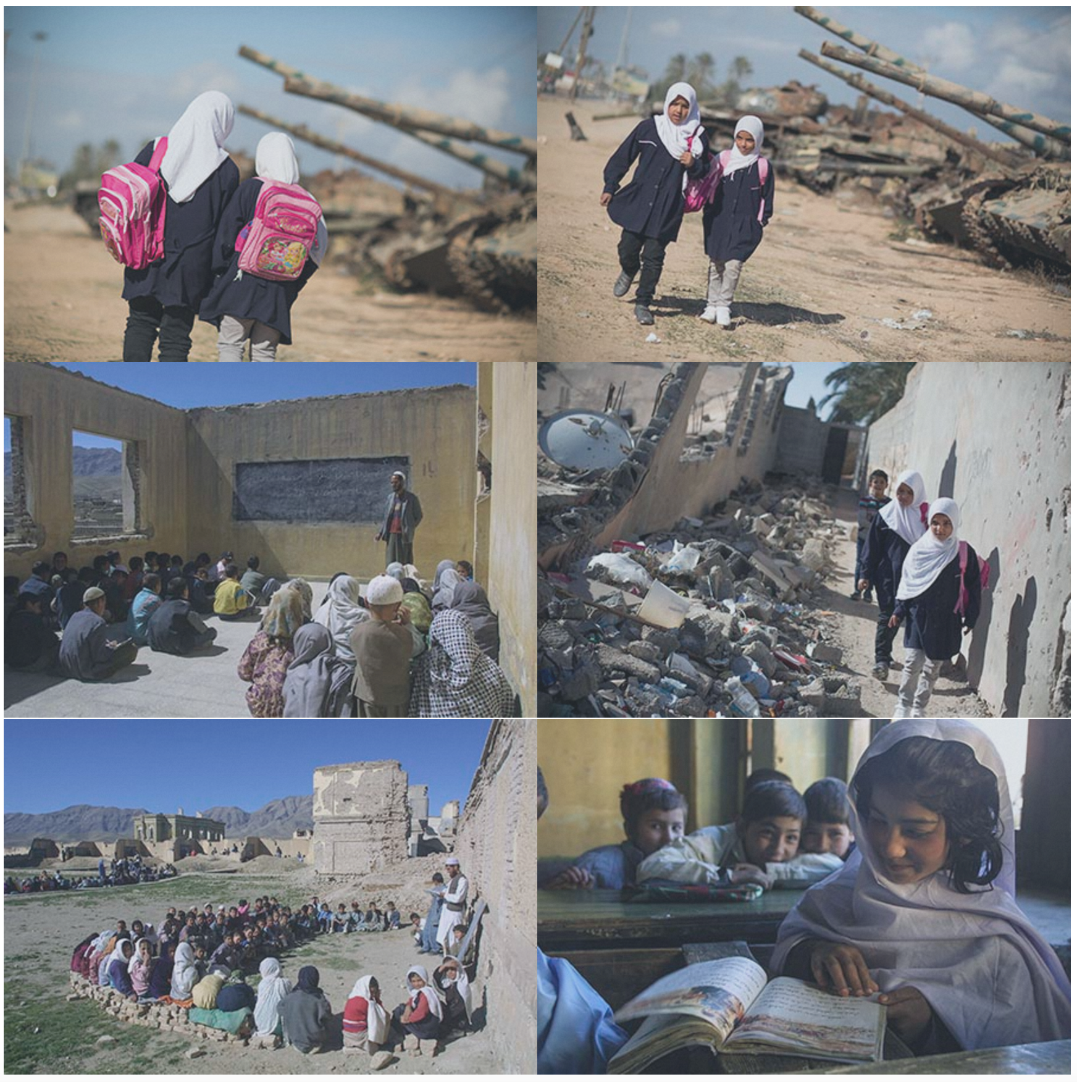
Attacks On Education
Education Above All: HH Sheikha Moza’s initiative
PEIC Vision-
A program of Education Above All, is a global
which aims to significantly reduce the numbers
of children worldwide who are missing out on
their right to education due to war conflicts,
Or insecurity that threaten
education. Teachers and students may
be killed, tortured or imprisoned.
School and universities may be destroyed.
PEIC aims to protect education in insecurity
and conflict.
Summer Project
To collect, analyze, and build machine
learning models for the automatic detection
of reports of attacks on education from
social media platforms such as Twitter.

Slide 3
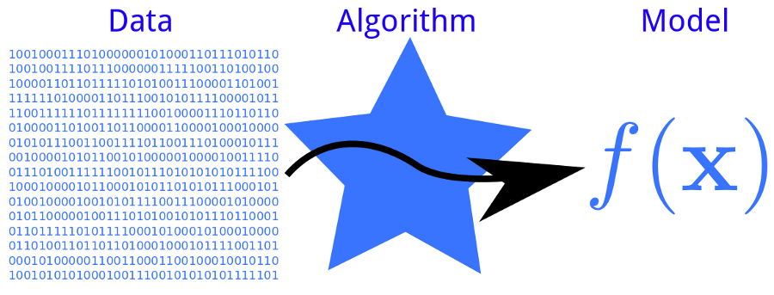
Project Goals
Summer Project
1- Understand supervised machine learning
2- Collect, analyze, and build machine learning models
to implement supervised machine learning for the
automatic detection of reports of attacks on education
from social media platforms such as Twitter.
Machine Learning

Slide 4
Outline
Processing Steps
Data Collection
De-duplication & Sampling
Labelling
Feature Extraction
Classifier Training
Evaluation & Results

Slide 5
1-Data collection-Using AIDR (Artificial Intelligence for Disaster Response) platform some 900k tweets related to attacks on education were collected.
2-Sampling- Ten batches each containing 1k unique tweets were sampled.
3-Labeling-The tweets were assigned different labels.
4-Cleaning & Feature selection- Using python regular expression library URLs from the tweets were removed. The NLTK corpus library was used to remove stop words
5-Classifier training- The dataset was split between training, development and testing data and using random forest & SVM- machine learning algorithms, the classifier was trained.
6-Evaluation- The result (precision & accuracy) from the classifier were displayed in a histogram.
Processing

Slide 6
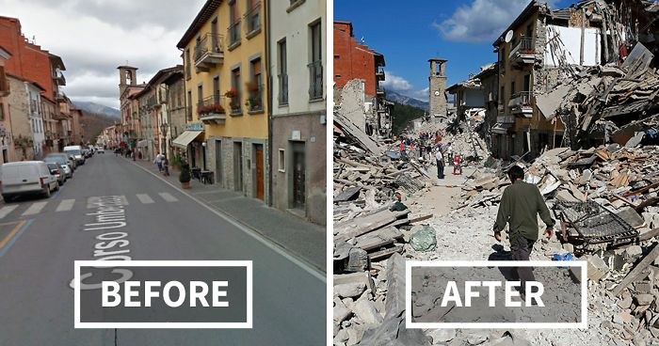
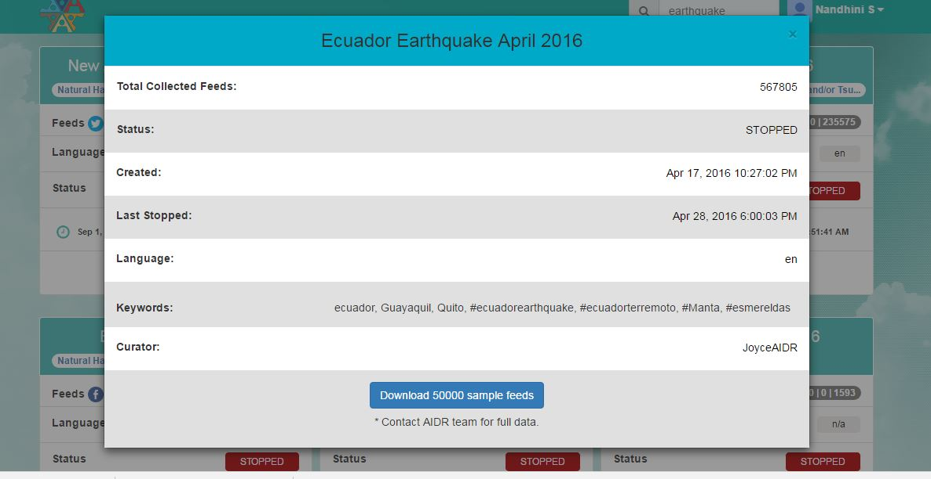

Data Collection
Type in the keywords like “Ecuador earthquake” to filter related tweets
Using AIDR platform, over 900k tweets related to attacks on education have been collected
Occurrence of a disaster

Slide 7
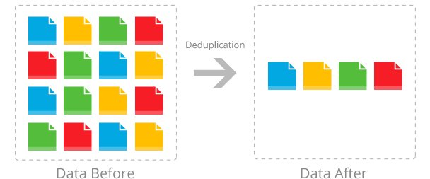
De duplication and Sampling
From the unique sets of tweets, a sample set of data is obtained for easy understanding.
Sampled ten batches each containing 1k unique tweets out of 900k tweets
From the collected tweets dataset, only unique data blocks are kept and all redundant tweets are eliminated.

Slide 8
Attacks on education categories
Reports of student or teacher:
Killed, murdered, assassinated, shot, suicide
Injured, wounded, tortured
Abducted, kidnapped, disappeared, detention, imprisoned
Raped, sexual violence or harassment
Threatened, extorted, abused
Forced labor
Forced marriage
Reports of school, college, university:
Damaged, destroyed, bombed, attacked, detonated
Shut, closed, evacuated

Slide 9
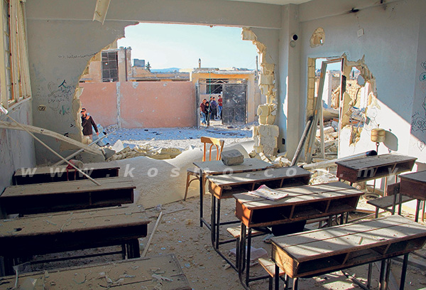
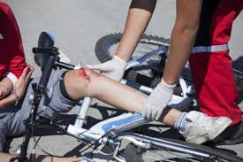
Labeling
Each of the sampled 1k tweets are given to human annotators for labeling.
Usually crowd sourcing is done and the human annotated tweets are used to train classifier models.
If a single tweet has different labels, a single label is assigned based on majority
Images are also annotated based on the content

Slide 10
Data Distribution
Inter-annotator agreement = >70%

Slide 11
Pre processing
Remove stop words
Remove urls
Lower casing
Clean input data
Remove punctuations
Gibberish values like
@ #$%():
Sort the data

Slide 12
Feature Extraction
In machine learning a feature is an individual measurable property of a phenomenon being observed. Choosing informative, discriminating and independent features is a crucial step in classification.
Text is represented in terms occurrence frequencies, then it can be transformed into a reduced set of features (also named a feature vector).
A feature vector is an n-dimensional vector of numerical features that represent some object.

Slide 13
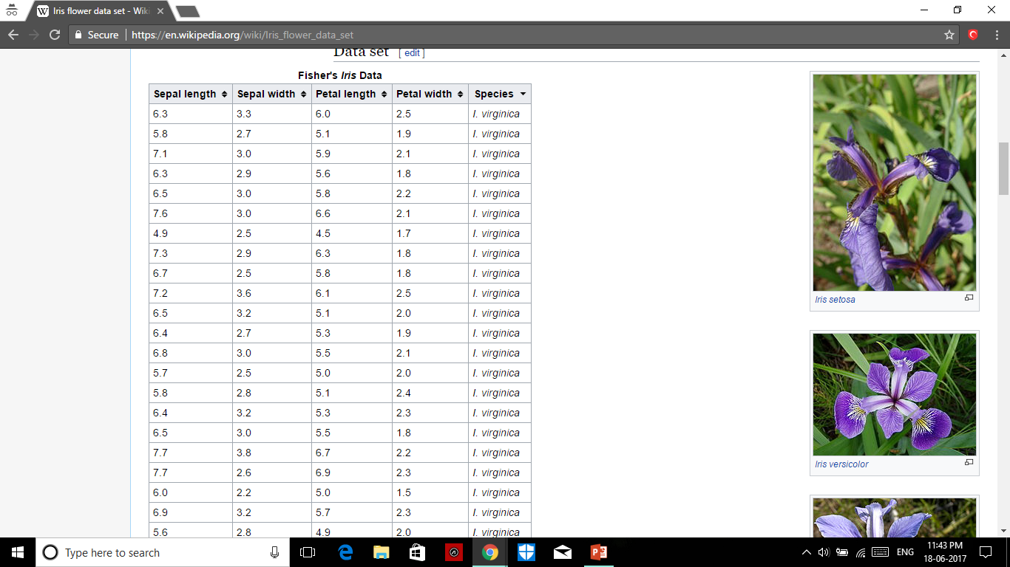
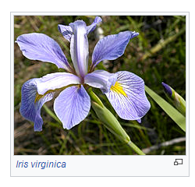
Sepal length Sepal width Petal length Petal width

Slide 14
Algorithms used for feature extraction
Count Vectorizer
Convert a collection of text documents to a matrix of token counts. This implementation produces a sparse representation of the counts.
Tfidf Vectorizer (Term frequency–Inverse document frequency)
A high weight in tf–idf is reached by a high term frequency (in the given document) and a low document frequency of the term in the whole collection of documents; the weights hence tend to filter out common terms.

Slide 15
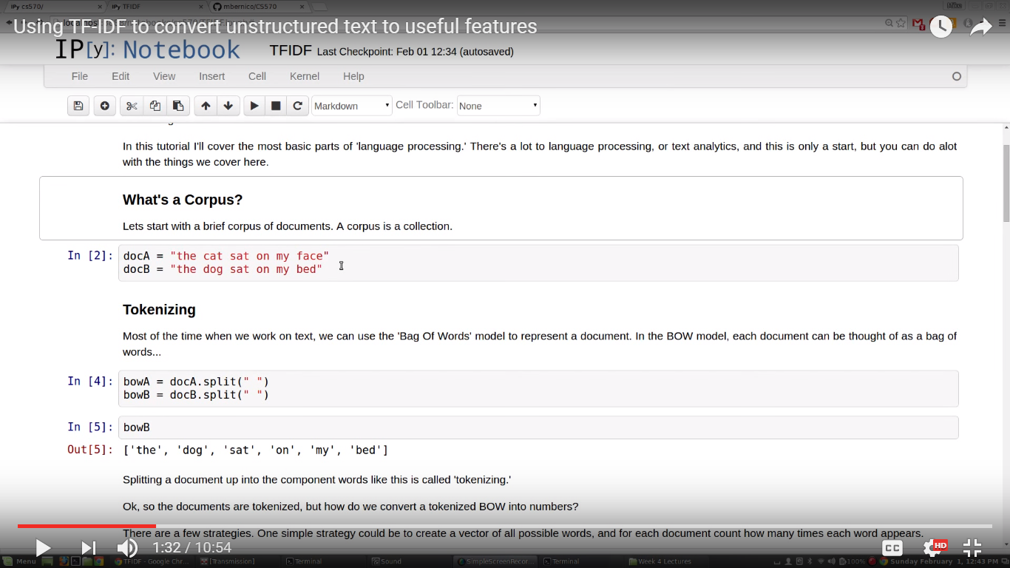
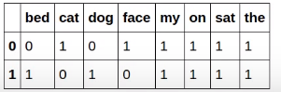
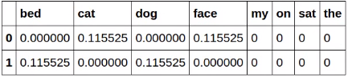
After tokenizing
Count Vectorizer
Tf- idf Vectorizer

Slide 16
TfidfVectorizer()
TfidfVectorizer parameters:
Stop_words: to remove stop words.
Lowercase: Convert all characters to lowercase before tokenizing.
Tokenizer: tokenizes the string.
max_features: maximum number of features.
ngram_range: The lower and upper boundary of the range of n-values for different n-grams to be extracted.

Slide 17
Classifiers
Random Forest
SVM:
1.Linear SVC
2.SVC
A. rbf
B. poly
C. linear

Slide 18
Random Forest Classifier
Random forests or random decision forests are an ensemble learning method for classification, regression and other tasks, that operate by constructing a multitude of decision trees at training time and outputting the class that is the mode of the classes (classification) or mean prediction (regression) of the individual trees.
RandomForestClassifier(n_estimators=20,n_jobs=1,max_features=990).fit(train_x_feat, train_true_y)
#best conditions chosen after repeated testing(for unigrams).
n_estimators: The number of trees in the forest.
n_jobs: The number of jobs to run in parallel for both fit and predict.
train_x_feat: term document matrix

Slide 19
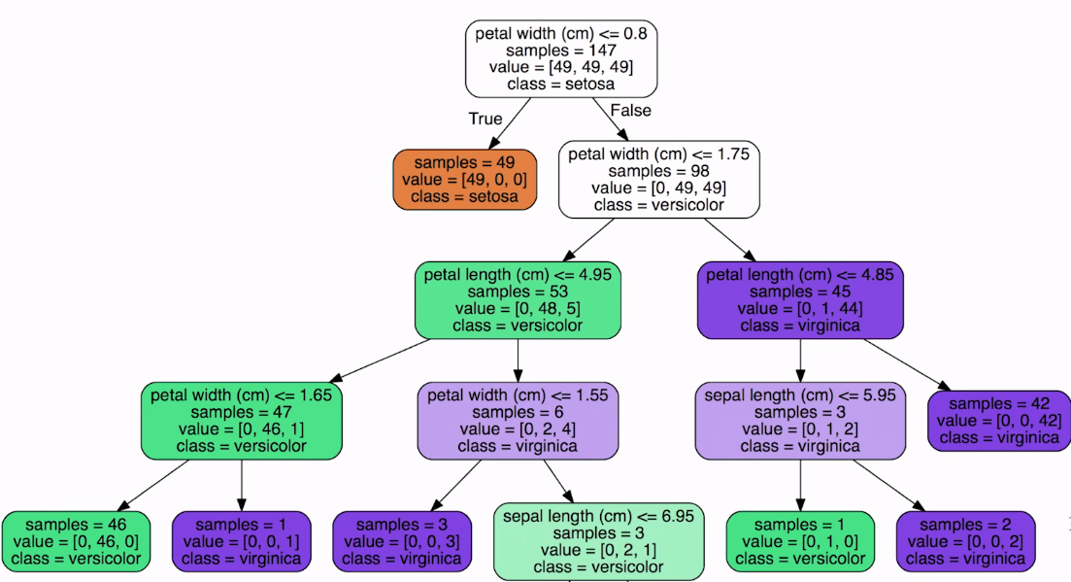
Sepal length=0.7
Sepal width=3.2
Petal length=4.7
Petal width=1.4

Slide 20
SVM
An SVM model is a representation of the examples as points in space, mapped so that the examples of the separate categories are divided by a clear gap that is as wide as possible. New examples are then mapped into that same space and predicted to belong to a category based on which side of the gap they fall.
sklearn provides following algorithms for classification:
1.LinearSVC
2.SVC (kernals : ’rbf’ , ’poly’ , ’linear’)
Out of the above 3 algorithms SVC gave best results (considering test average values ) after finding threshold for different combinations of parameters(Class weight were default).
SVC(kernel='linear',C=2.87,shrinking=True)

Slide 21
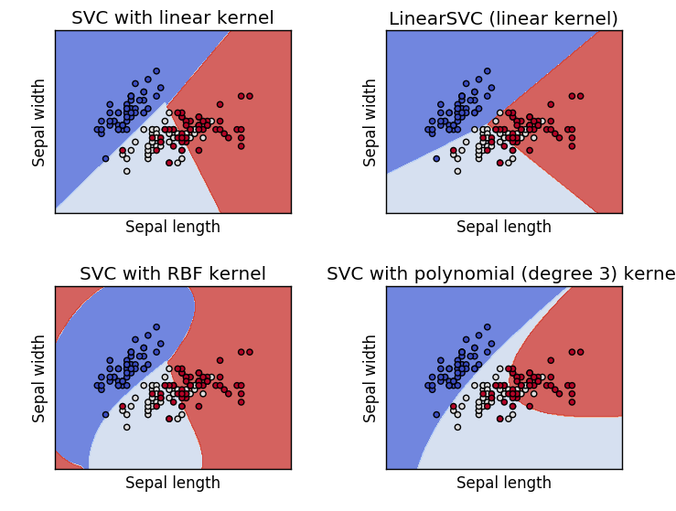

Slide 22
Train and Test dataset
Training dataset
60% of input data
Clean input data file
20% of input data
Development dataset
20% of input data
Testing dataset

Slide 23
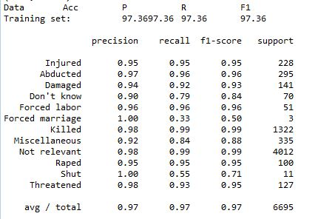
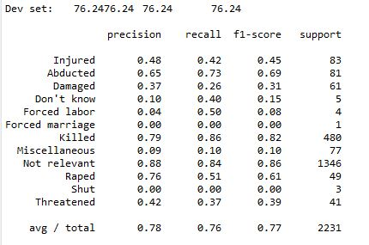
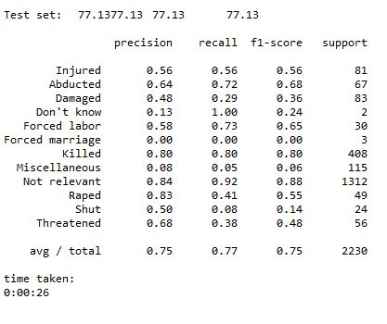
Result Using Random Forest Classifier

Slide 24
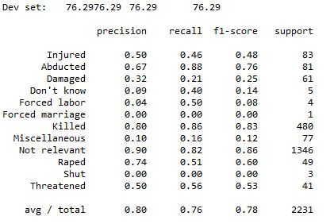
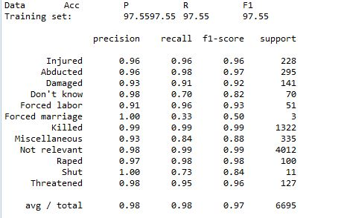
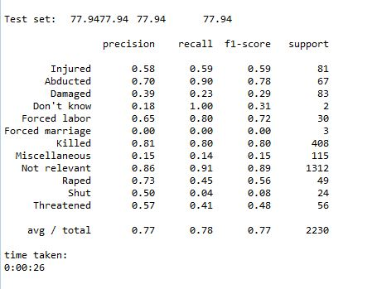
Result Using SVM Classifier

Slide 25
Next Steps
Improve the performance of our model by having evenly distributed tweets among all the classes.
To help make predictions for unclassified tweets.

